Slide 1
Clustering

Slide 2
Unsupervised learning is the training of a machine using information that is neither classified nor labeled and allowing the algorithm to act on that information without guidance.
Here the task of the machine is to group unsorted information according to similarities, patterns, and differences without any prior training of data.
Unlike supervised learning, no teacher is provided that means no training will be given to the machine.
Therefore the machine is restricted to find the hidden structure in unlabeled data by itself.
For instance, suppose it is given an image having both dogs and cats which it has never seen.

Slide 3
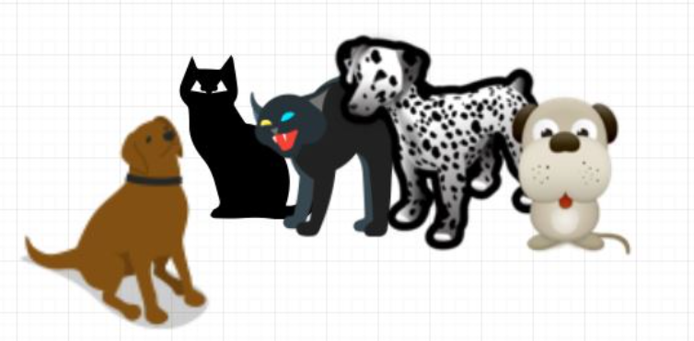
Thus the machine has no idea about the features of dogs and cats so we can’t categorize it as ‘dogs and cats ‘.
But it can categorize them according to their similarities, patterns, and differences, i.e., we can easily categorize the above picture into two parts.
The first may contain all pics having dogs in them and the second part may contain all pics having cats in them.
Here you didn’t learn anything before, which means no training data or examples.

Slide 4
It allows the model to work on its own to discover patterns and information that was previously undetected. It mainly deals with unlabelled data.
Unsupervised learning is classified into two categories of algorithms:
Clustering: A clustering problem is where you want to discover the inherent groupings in the data, such as grouping customers by purchasing behavior.
Association: An association rule learning problem is where you want to discover rules that describe large portions of your data, such as people that buy X also tend to buy Y.

Slide 5
Unsupervised machine learning analyzes and clusters unlabeled datasets using machine learning algorithms.
These algorithms find hidden patterns and data without any human intervention, i.e., we don’t give output to our model.
The training model has only input parameter values and discovers the groups or patterns on its own.
Data-set in Figure A is Mall data that contains information about its clients that subscribe to them. Once subscribed they are provided a membership card and the mall has complete information about the customer and his/her every purchase.
Now using this data and unsupervised learning techniques, the mall can easily group clients based on the parameters we are feeding in.

Slide 6
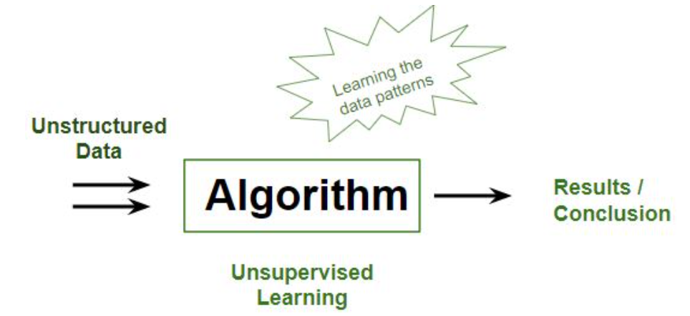
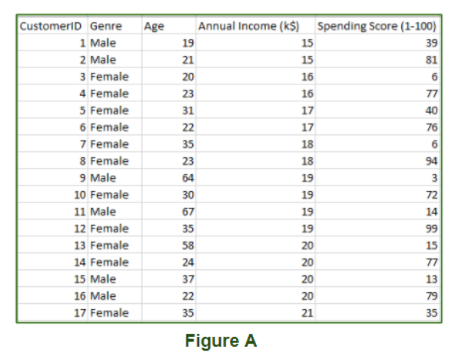

Slide 7
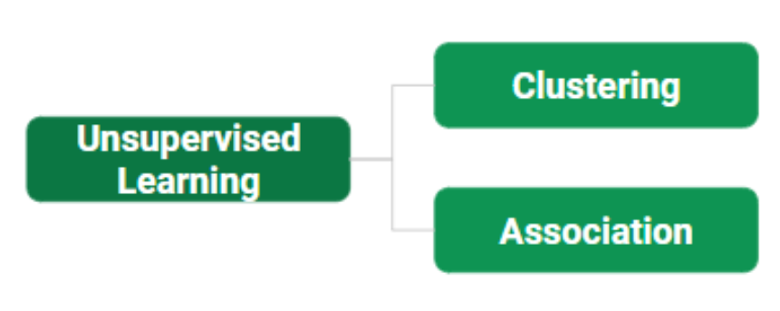
The input to the unsupervised learning models is as follows:
Unstructured data: May contain noisy(meaningless) data, missing values, or unknown data
Unlabeled data: Data only contains a value for input parameters, there is no targeted value(output). It is easy to collect as compared to the labeled one in the Supervised approach.

Slide 8
Types of Unsupervised Learning:-
Clustering
Exclusive (partitioning)
Agglomerative
Overlapping
Probabilistic
Clustering Types:-
Hierarchical clustering
K-means clustering
Principal Component Analysis
Singular Value Decomposition
Independent Component Analysis

Slide 9
Introduction to Clustering
An unsupervised learning method is a method in which we draw references from datasets consisting of input data without labeled responses.
Generally, it is used as a process to find meaningful structure, explanatory underlying processes, generative features, and groupings inherent in a set of examples.
Clustering is the task of dividing the population or data points into a number of groups such that data points in the same groups are more similar to other data points in the same group and dissimilar to the data points in other groups.
It is basically a collection of objects on the basis of similarity and dissimilarity between them.

Slide 10
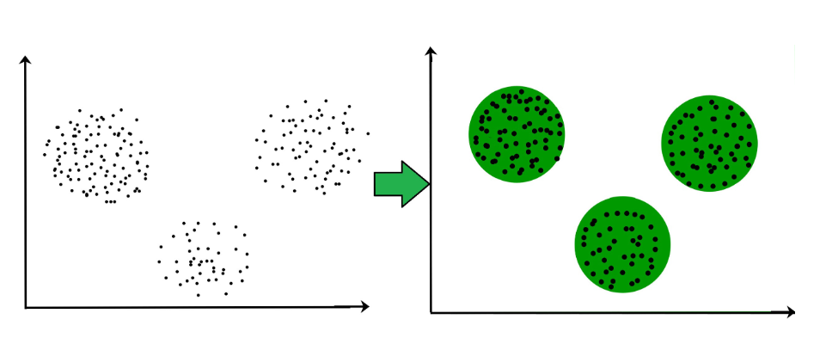
For ex– The data points in the graph below clustered together can be classified into one single group. We can distinguish the clusters, and we can identify that there are 3 clusters in the below picture.

Slide 11
Clustering Methods :
Density-Based Methods: These methods consider the clusters as the dense region having some similarities and differences from the lower dense region of the space.
These methods have good accuracy and the ability to merge two clusters.
Example DBSCAN (Density-Based Spatial Clustering of Applications with Noise), OPTICS (Ordering Points to Identify Clustering Structure), etc.
Hierarchical Based Methods: The clusters formed in this method form a tree-type structure based on the hierarchy.
New clusters are formed using the previously formed one. It is divided into two category
Agglomerative (bottom-up approach)
Divisive (top-down approach)

Slide 12
Partitioning Methods: These methods partition the objects into k clusters and each partition forms one cluster.
This method is used to optimize an objective criterion similarity function such as when the distance is a major parameter example K-means, CLARANS (Clustering Large Applications based upon Randomized Search), etc.
Grid-based Methods: In this method, the data space is formulated into a finite number of cells that form a grid-like structure.
All the clustering operations done on these grids are fast and independent of the number of data objects example STING (Statistical Information Grid), wave cluster, CLIQUE (CLustering In Quest), etc.

Slide 13
Hierarchical clustering, also known as hierarchical cluster analysis or HCA, is an unsupervised machine learning approach for grouping unlabeled datasets into clusters.
The hierarchy of clusters is developed in the form of a tree in this technique, and this tree-shaped structure is known as the dendrogram.
Separating data into groups based on some measure of similarity, finding a technique to quantify how they're alike and different, and limiting down the data is what hierarchical clustering is all about.
Hierarchical clustering method functions in two approaches-
Agglomerative
Divisive

Slide 14
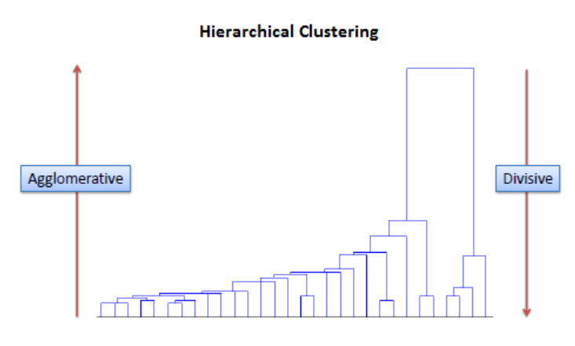
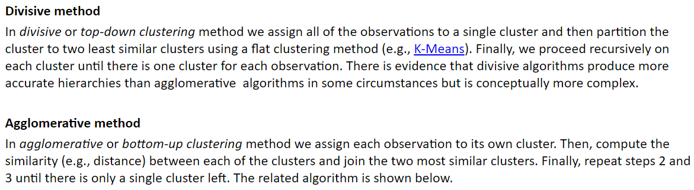

Slide 15
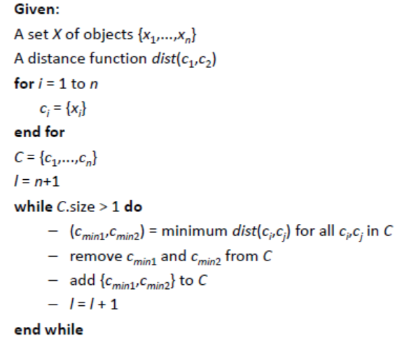
Before any clustering is performed, it is required to determine the proximity matrix containing the distance between each point using a distance function.
Then, the matrix is updated to display the distance between each cluster.
The following three methods differ in how the distance between each cluster is measured.

Slide 16
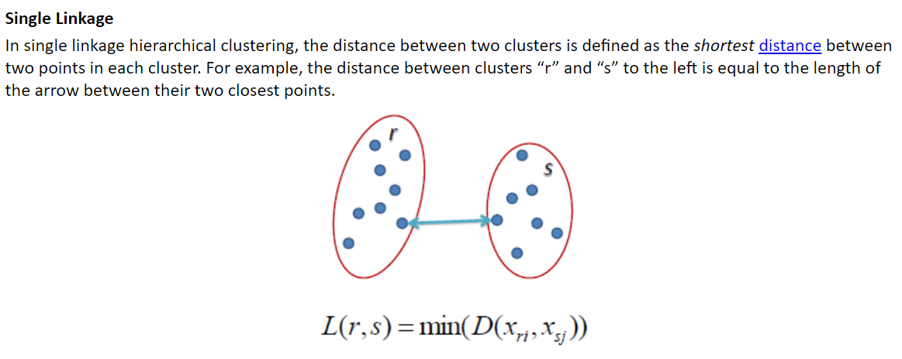

Slide 17
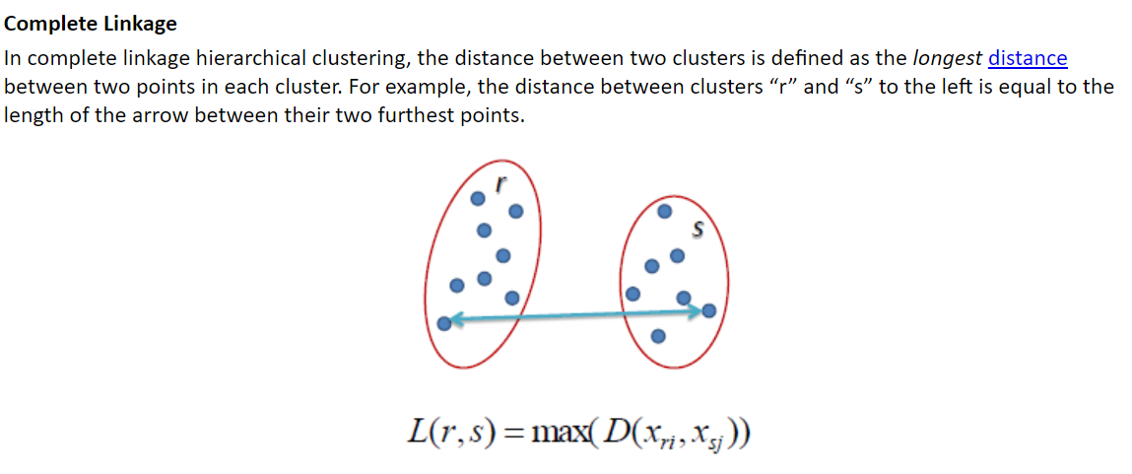

Slide 18
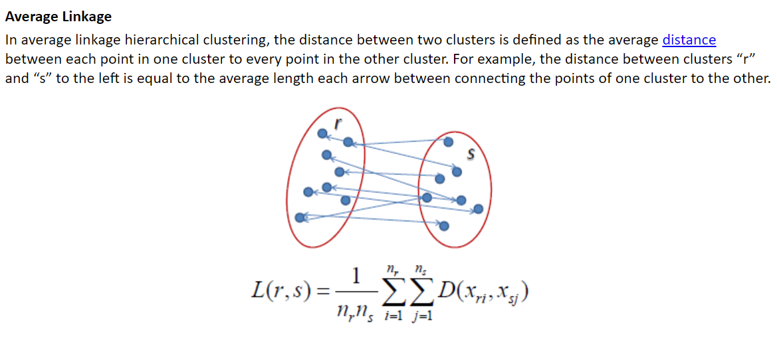

Slide 19
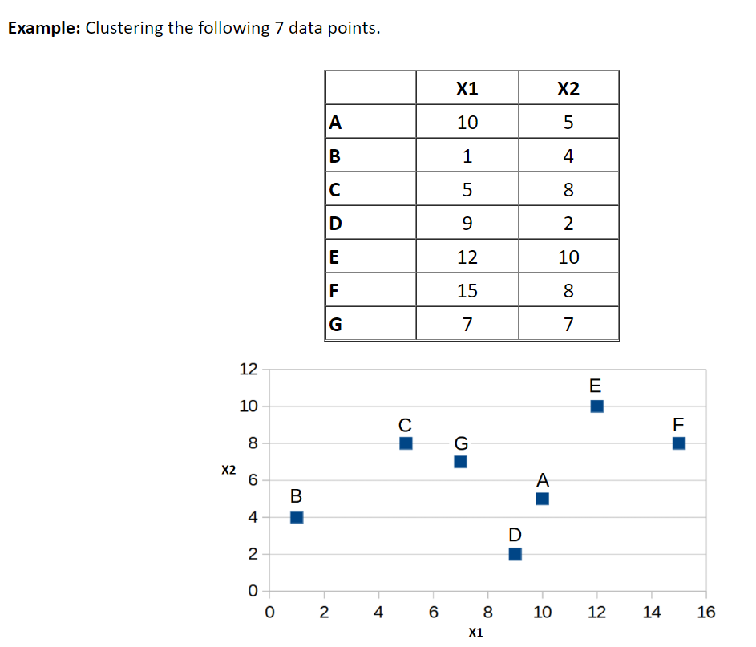

Slide 20
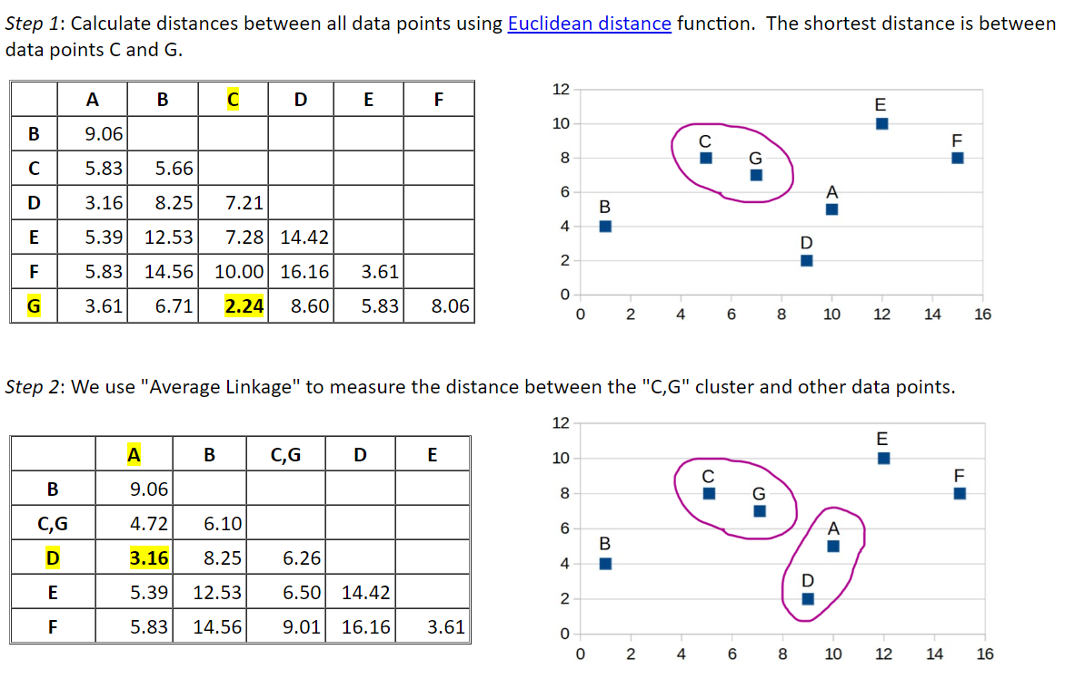

Slide 21
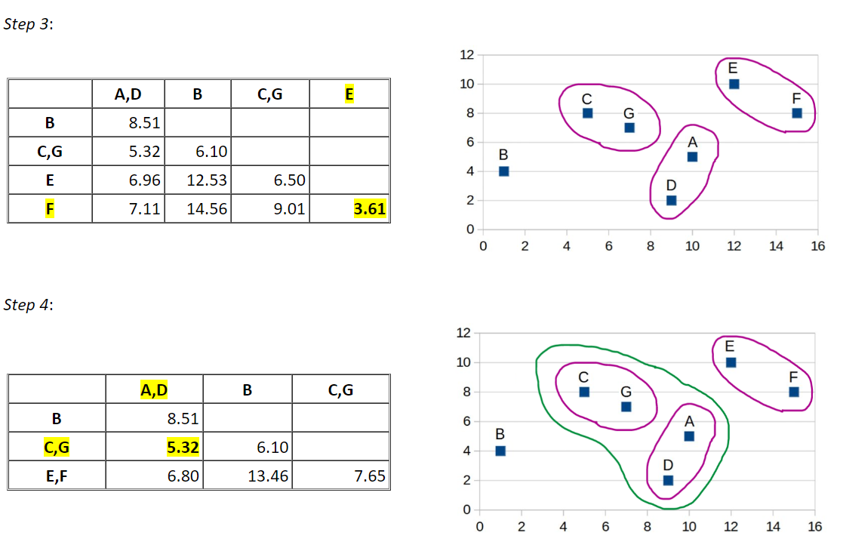

Slide 22
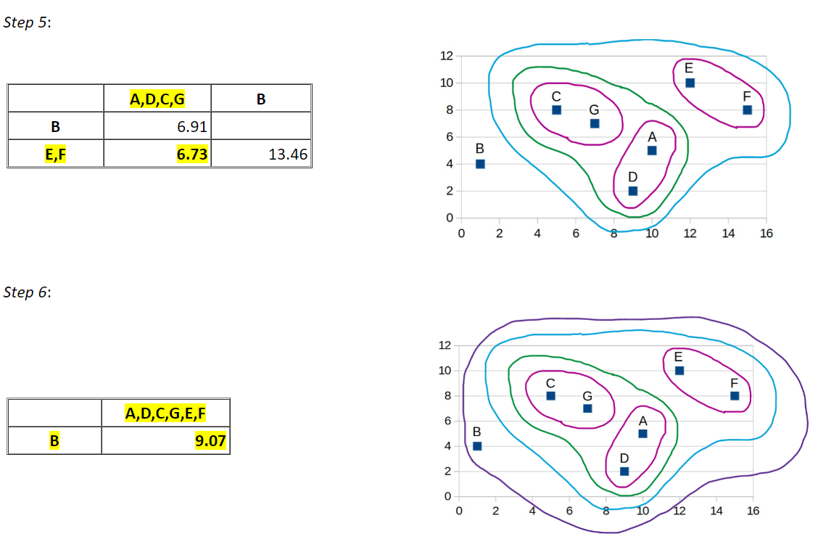

Slide 23
